Slide 1

CREDI MANAGER
- SECURE SHARING OF STUDENT'S CREDENTIALS -

Slide 2


TABLE OF CONTENT
1
2
3
INTRODUCTION & Problem statement
MOTIVATION
lIterature revIew
4
5
6
GAPS & SCOPE
ImplementatIon
DEPLOYMENT

Slide 3





INTRODUCTION
THERE ARE CERTAIN DOCUMENTS IN A LIFETIME WHICH ARE ESSENTIAL WHEN A SEARCH OF A PROFESSIONAL CAREER SUCH AS DEGREE CERTIFICATES, TRANSCRIPTS, LETTER OF RECOMMENDATAIONS, INTERNSHIPS AND TRAINING CERTIFICATES, ETC.

Slide 4
PROBLEM STATEMENT
THE VERIFICATION PROCESS OF THE CREDENTIALS ISSUED BY INSTITUTIONS IS TIME-CONSUMING, COSTLY, AND VERY TEDIOUS. IF AN APPLICANT ISSUES THESE CREDENTIALS BY THEMSELVES, IT STILL REQUIRES TO BE VERIFIED BY THE COMPANIES FOR ITS CREDIBILITY.

Slide 5

MOTIVATION
BLOCKCHAIN DOESN'T STORE ANY INFORMATION IN A CENTRAL LOCATION INSTEAD IT COPIES AND SPREADS ACROSS A WHOLE NETWORK OF COMPUTERS.
THERE HASN'T BEEN ANY PRODUCTION APPLICATION IN THE MARKET.

Slide 6





PROJECT TIMELINE
Research
DESIGN
IMPLEMENTATION
Deployment

Slide 7



LITERATURE REVIEW
THERE HAVE BEEN A FEW STUDIES ON USING A BLOCKCHAIN-BASED ARCHITECTURE IN THE EDUCATION SYSTEM WHICH DICTATES THE BENEFITS AND CHALLENGES OF USING A BLOCKCHAIN-BASED CREDENTIAL ISSUING/SHARING SYSTEM THAT COULD BE EASILY ACCESSIBLE, VERIFIABLE, FASTER, AND COST-EFFECTIVE. HOWEVER, THESE SYSTEMS WERE PROPOSED FOR INDIVIDUAL SCHOOLS.

Slide 8
LITERATURE REVIEW
SOME OF THE RECENT PAPERS HAVE PRESENTED THE BENEFITS AND THE CHALLENGES OF USING BLOCKCHAIN TECHNOLOGY IN EDUCATION. HOWEVER, THERE IS STILL A NEED TO DESIGN A WORKING PROTOTYPE OF STUDENT-CREDENTIAL SHARING PLATFORM WHICH CAN OFFER SERVICES FOR ALL THE STAKEHOLDERS IN THE EDUCATION ECOSYSTEM.

Slide 9
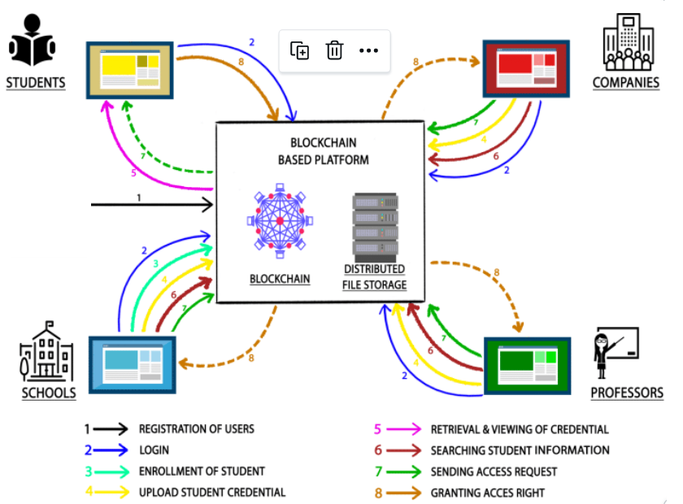




GAPS & SCOPE
EXISTING SYSTEMS ARE PROPOSED ONLY FOR INDIVIDUAL STAKEHOLDERS.
MOST OF THE PROPOSED SYSTEMS DO NOT CONSIDER COMPANIES AS STAKEHOLDERS.
DECENTRALIZED STORAGE OF CREDENTIALS.
THERE HASN'T BEEN ANY PRODUCTION APPLICATION IN THE MARKET.

Slide 10

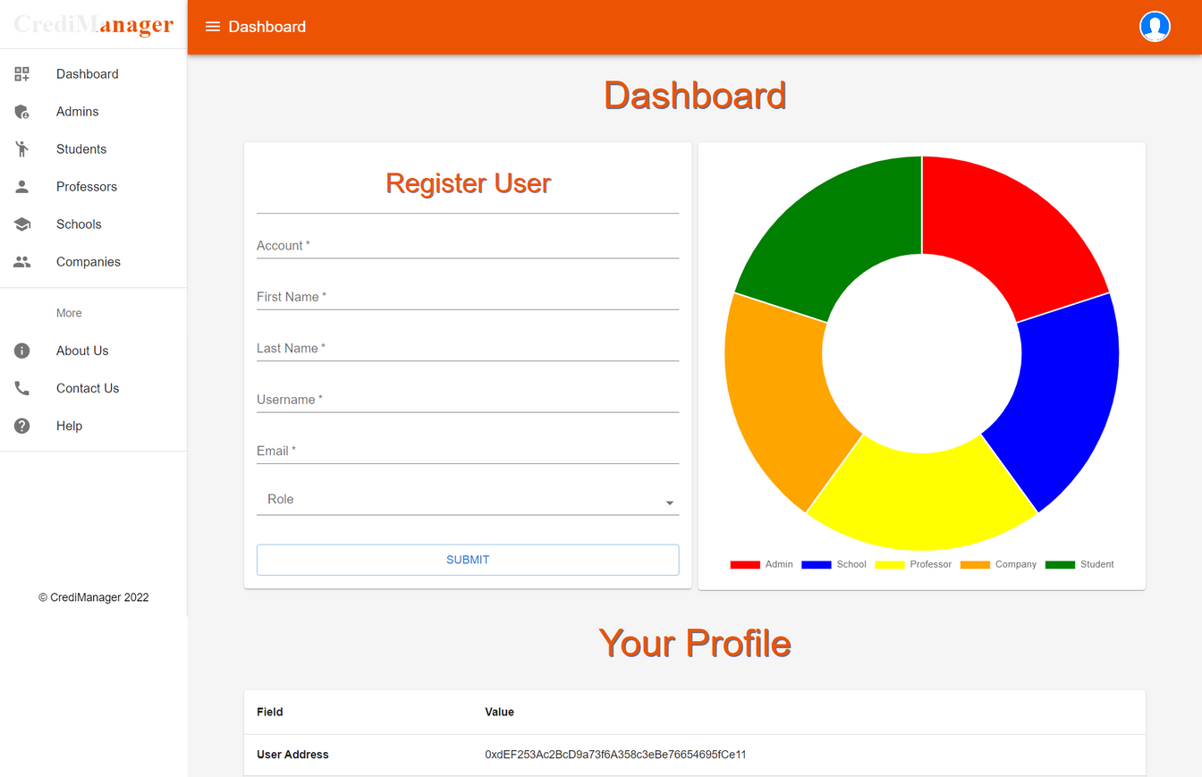
Admin's Dashboard
IMPLEMENTATION

Slide 11
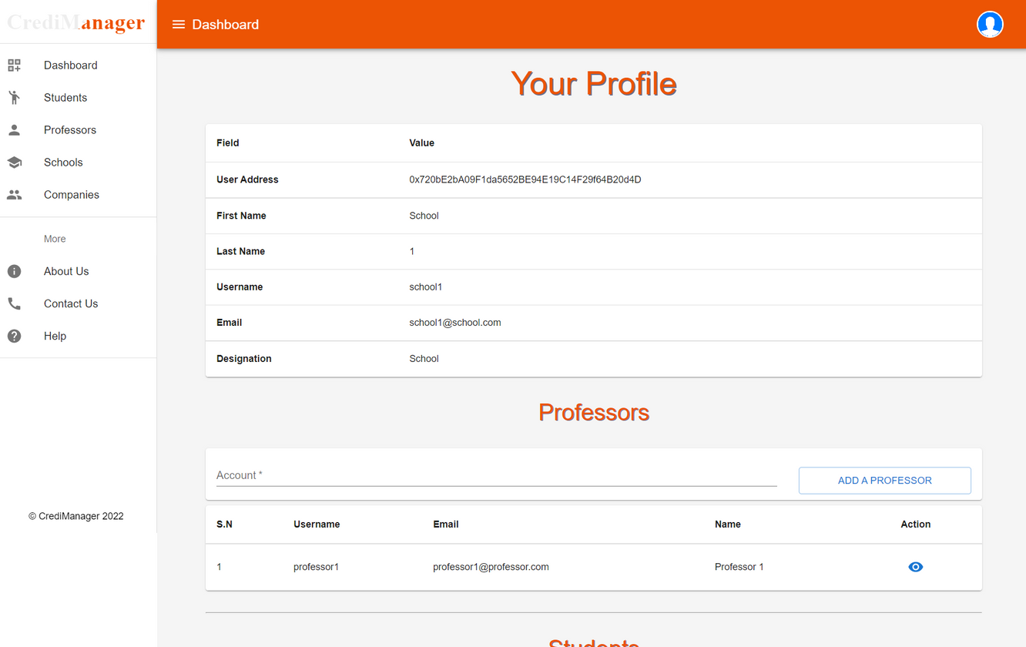
School's Dashboard
IMPLEMENTATION

Slide 12
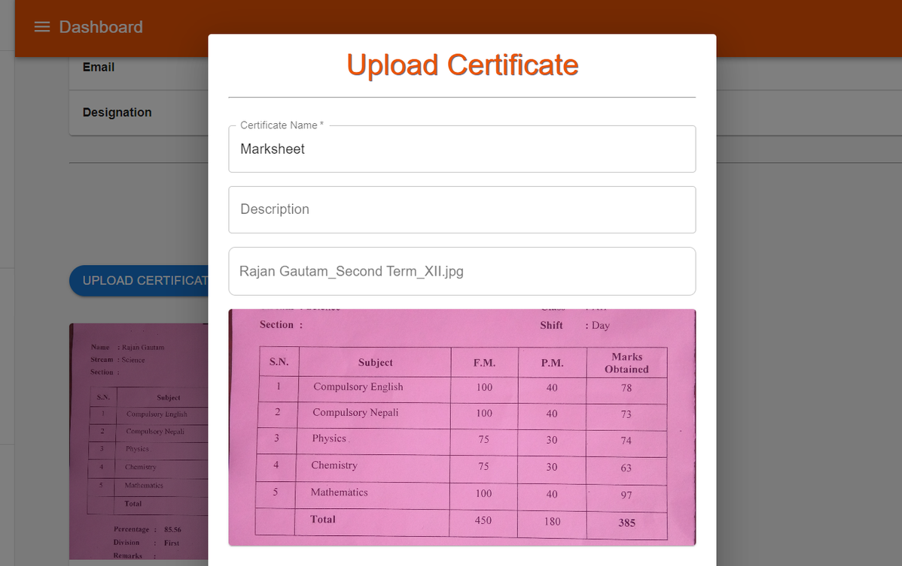
School's Dashboard
IMPLEMENTATION

Slide 13
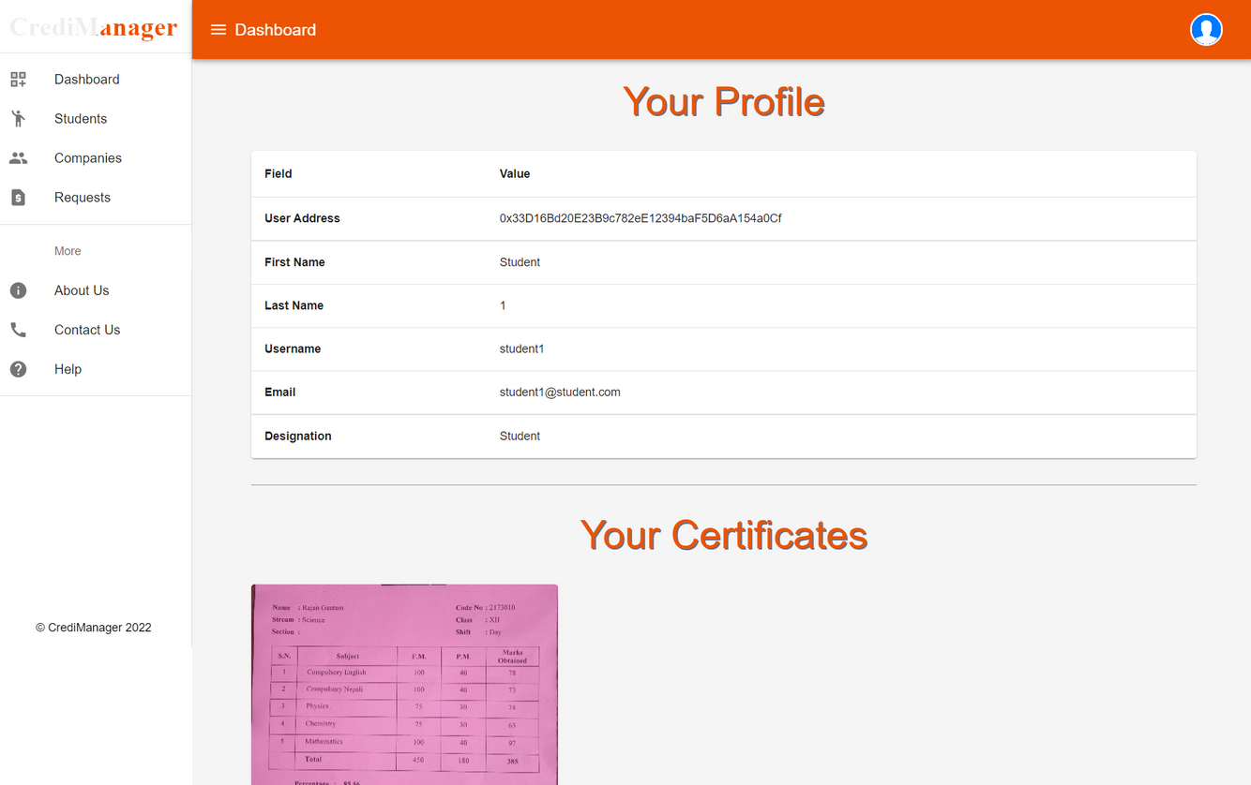
Student's Dashboard
IMPLEMENTATION

Slide 14
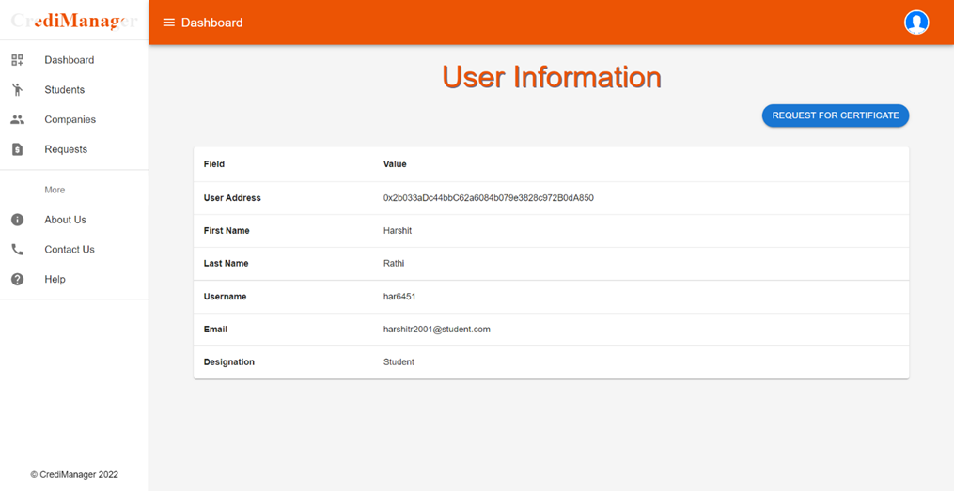

Company's Dashboard
IMPLEMENTATION

Slide 15
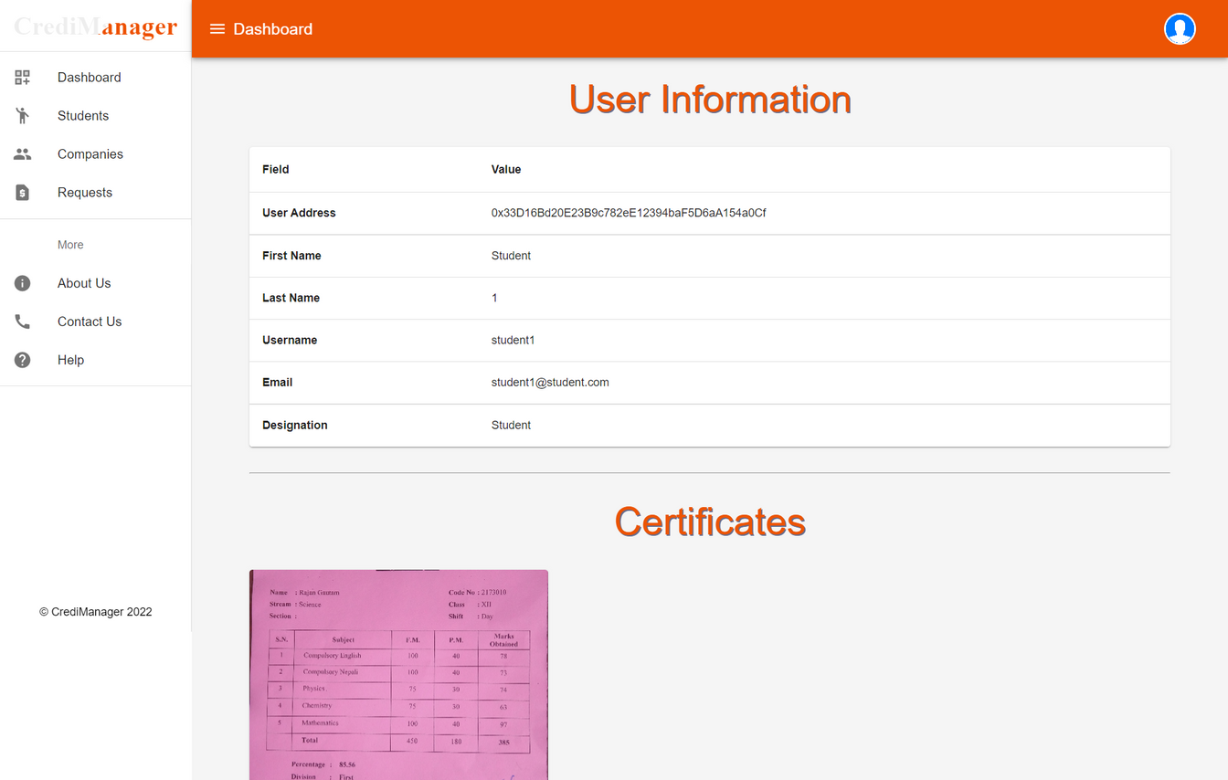
Company's Dashboard
IMPLEMENTATION

Slide 16

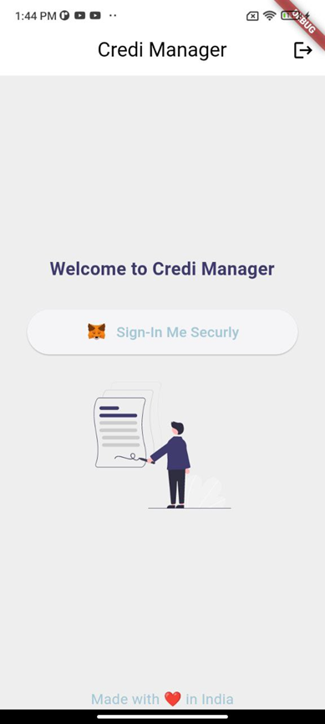
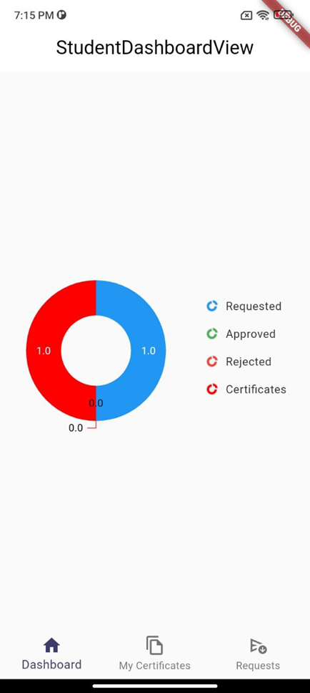
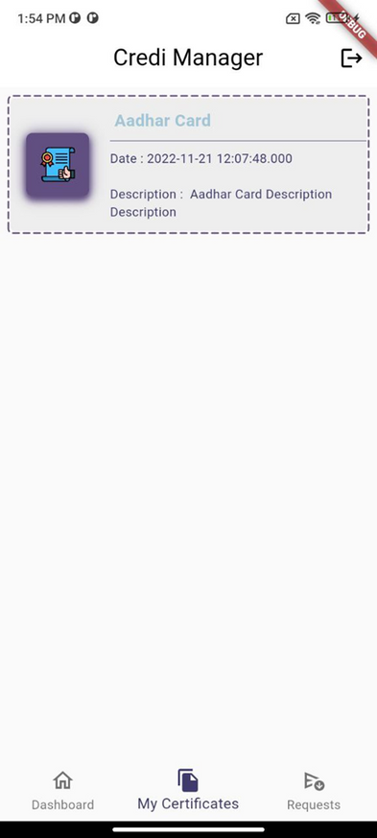
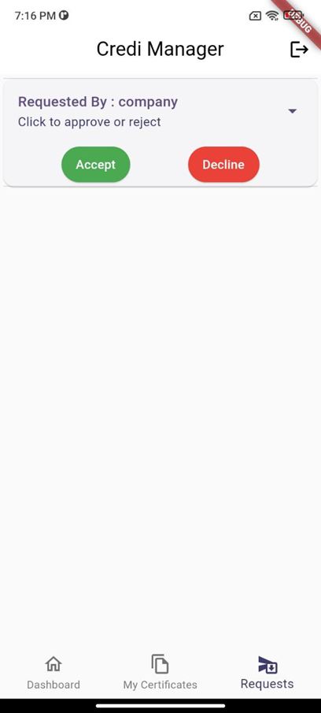
Student's Dashboard
IMPLEMENTATION

Slide 17
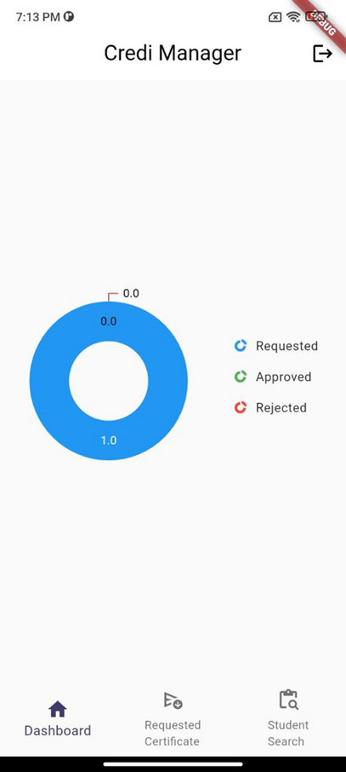
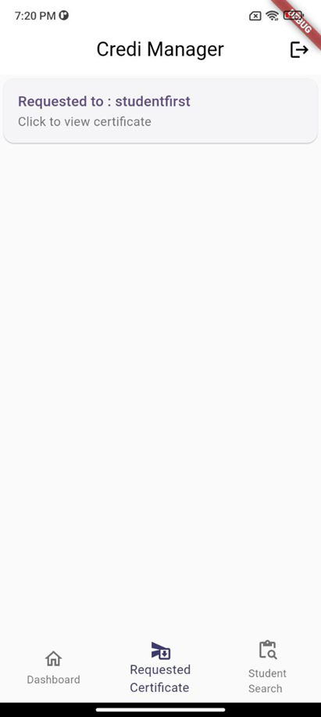
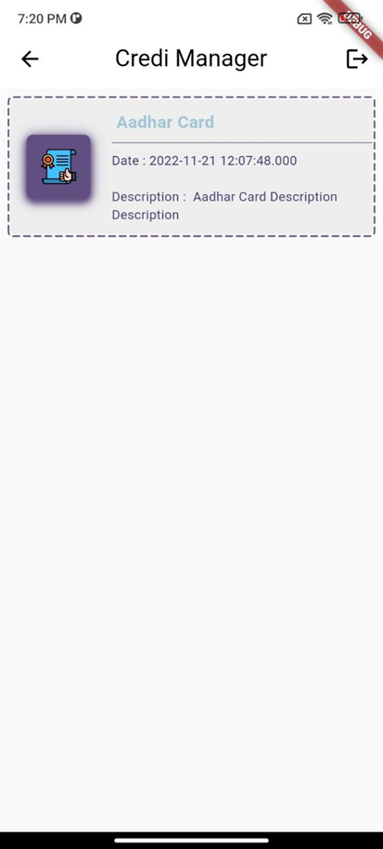
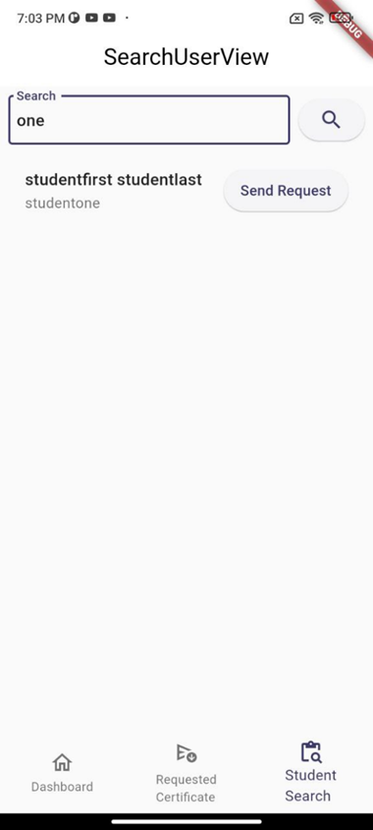
Company's Dashboard
IMPLEMENTATION

Slide 18
DEPLOYMENT
Codebase:
Web Application: https://github.com/rgautam320/CrediManager
Mobile Application: https://github.com/KunjKanani/CrediManager
Web Application:
Vercel: https://credi-manager.vercel.app
Docker Hub: https://hub.docker.com/repository/docker/rgautam320/credi

Slide 19
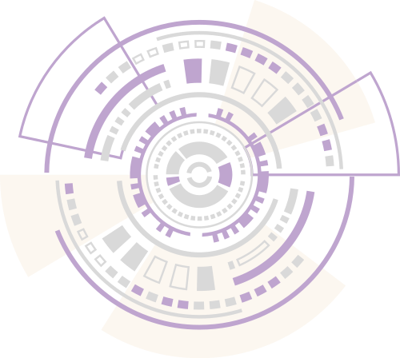

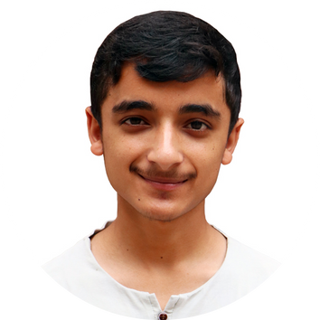
MEET OUR TEAM
Kunj KanaNI
Rajan Gautam
Mobile App and Blockchain Developer
Web App and Blockchain
Developer

Slide 20

Thank You

